Slide 1
JS
HTTP REQUEST
GET – POST - PUT

Slide 2

What this code will print ?
console.log(‘AA')
setTimeout(() => {
console.log(‘BB2’)
}, 2000)
console.log(‘CC')

Slide 3


SYNCHRONOUS
ASYNCHRONOUS

Slide 4

OBJECTIVES
What is a HTTP request ?
Understand a GET request
setTimeOut to call a function after some time

Slide 5


You want to know what
Is the weather in New York…

Slide 6



Because you cannot guess…
You need to ask to a web service
REQUEST
RESPONSE
(FRONT )
WEB SERVICE !

Slide 7
To answer to your request
there is a computer working 24/24h :
the server
REQUEST
RESPONSE
(CLIENT)
(SERVER)

Slide 8
The client is the one who makes the HTTP request.
WEATHER OF NEW YORK .?
(CLIENT)
(SERVER)

Slide 9
The server is a program who receives the request and sends the response.
WEATHER OF NEW YORK .?
34 ° C
(CLIENT)
(SERVER)

Slide 10
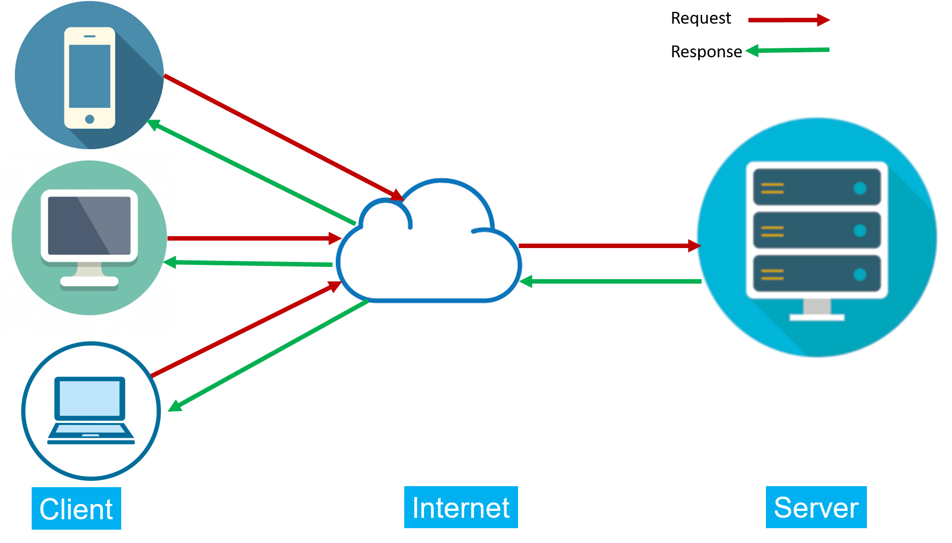
With internet, the server can serve
many clients

Slide 11
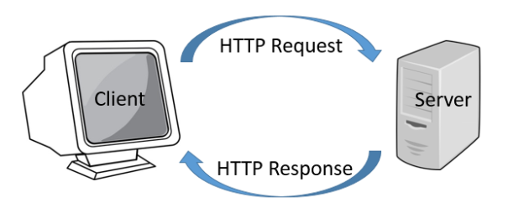
HTTP is the format used to structure request and responses on communication between a client and a server

Slide 12
GET is used to get data from a specified resource.
GET https://www.weather.com?city=newYork
HOST OF THE SERVER
PARAMETERS
<GET URL>

Slide 13

Axios is used to send an HTTP request and handle their responses,

Slide 14
(REQUEST)
GET https://api.genderize.io?name=peter
CLIENT
SERVER
(RESPONSE)
{
"name": "peter",
"gender": "male",
"probability": 0.99,
"count": 165452
}

Slide 15

Load AXIOS and use AXIOS
<script src="https://unpkg.com/axios/dist/axios.min.js"></script>
1- Load AXIOS library
axios.get( <GET URL> ).then( <YOUR CALLBACK> );
2- AXIOS
Is a global
variable

Slide 16

PRACTICE
ACTIVITY 1
10 MIN
GET https://api.genderize.io?name=peter
1 – Run this request using the REST Client in VS CODE:
- Find the data in the response
2 – Run this request using AXIOS get:
- Find the data in the response

Slide 17
THEN : WHAT YOU WILL DO WHEN
THE REPONSE IS ARRIVED WITH SUCCESS
axios
.get(“www.weather?city=Paris")
.then(function (response) {
let weather = response.data.weather;
});
ASYNCHRONOUS !!

Slide 18
CATCH : WHAT YOU WILL DO WHEN
THE REPONSE IS ARRIVED WITH ERROR
axios
.get(“www.weather?city=Paris")
.then(function (response) {
let weather = response.data.weather;
})
.catch(function (error) {
console.log(error);
})
;
ASYNCHRONOUS !!
ASYNCHRONOUS !!

Slide 19
CLIENT
SERVER
axios
.get(...)
.then(...)
.catch(...)
GET <URL>
SUCCESS
FAIL

Slide 20
PRACTICE
ACTIVITY 2
10 MIN
See instruction in code

Slide 21

What this code will print ?
script.js
axios.get("data.json").then(response => console.log(response.data.class));
data.json
{
"name": "Molika Heng",
"nickname": "Kaka",
"class": "WEP A"
}

